Slide 1
杂题选讲 20240116
Xiao D

Slide 2
[JOISC2022] 团队竞技
Luogu P9525

Slide 3
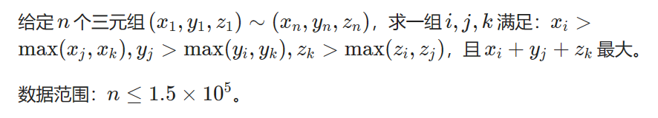
[JOISC2022] 团队竞技

Slide 4
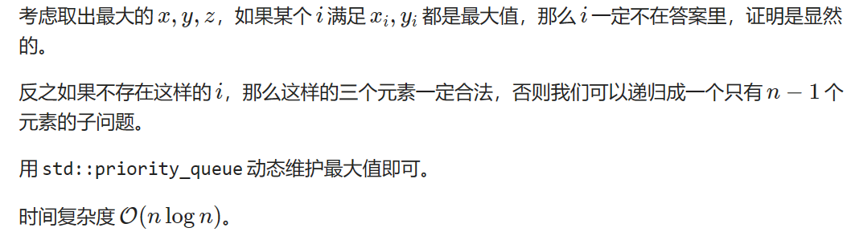
[JOISC2022] 团队竞技

Slide 5
[IOI2012] Rings
Luogu P6165

Slide 6
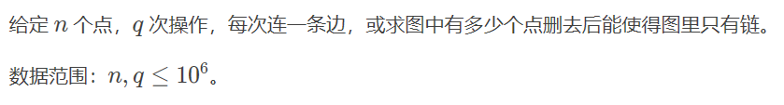
[IOI2012] Rings

Slide 7
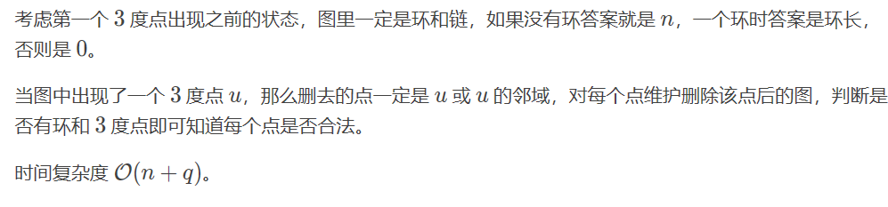
[IOI2012] Rings

Slide 8
[JOISC2020] Buildings 4
Luogu P6891

Slide 9
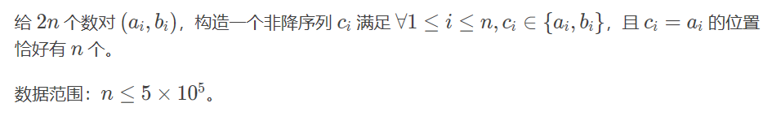
[JOISC2020] Buildings 4

Slide 10
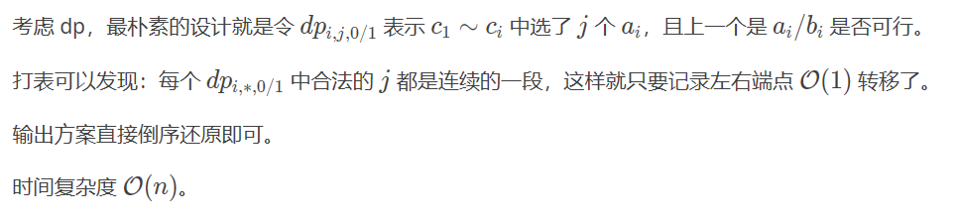
[JOISC2020] Buildings 4

Slide 11
[BalticOI 2014] Sequence
Luogu P6740

Slide 12
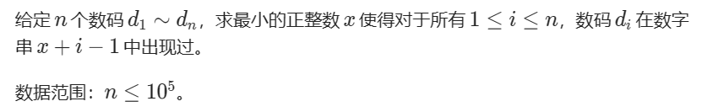
[BalticOI 2014] Sequence

Slide 13
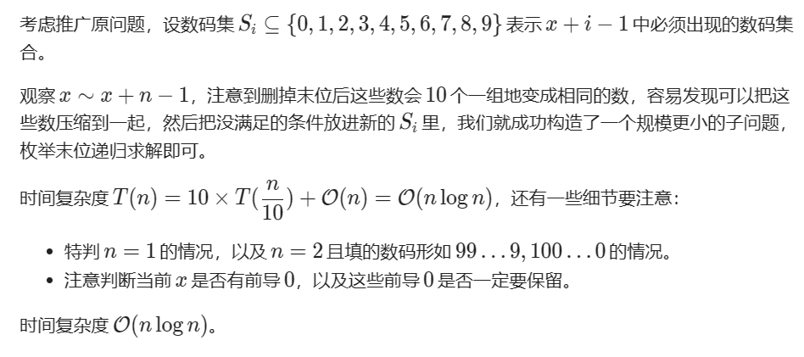
[BalticOI 2014] Sequence

Slide 14
[JOISC2020] Constellation 3
Luogu P7219

Slide 15
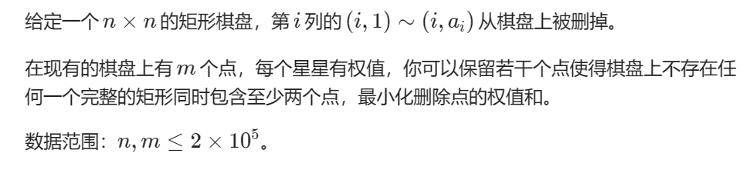
[JOISC2020] Constellation 3

Slide 16
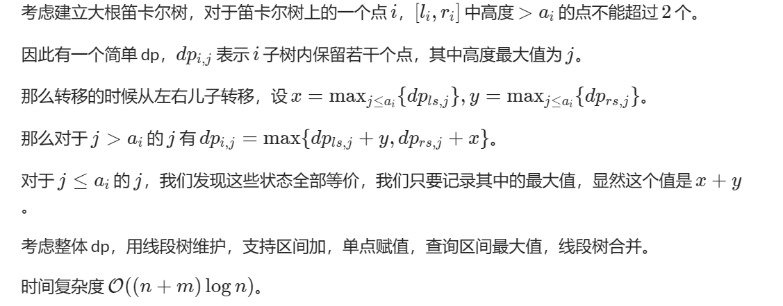
[JOISC2020] Constellation 3

Slide 17
Partial Virtual Trees
CodeForces 1707D

Slide 18
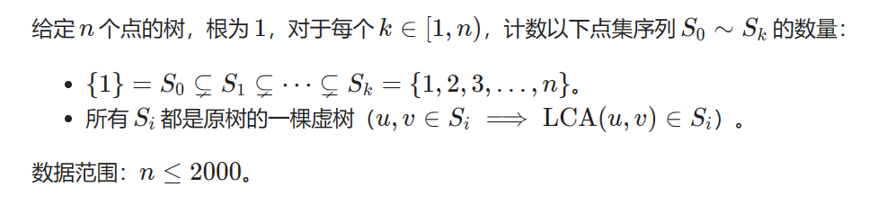
CF1707D Partial Virtual Trees

Slide 19
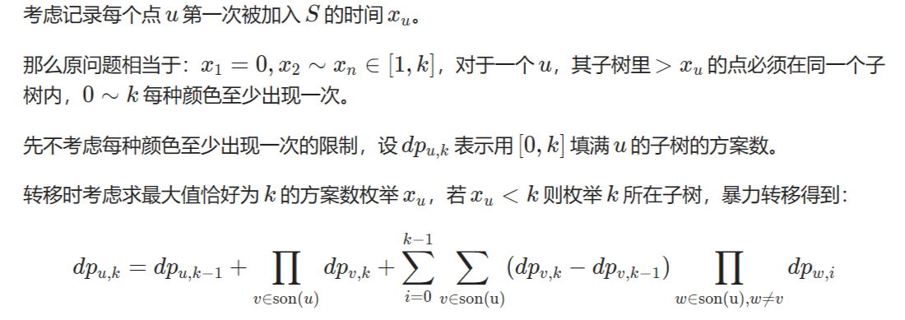
CF1707D Partial Virtual Trees

Slide 20
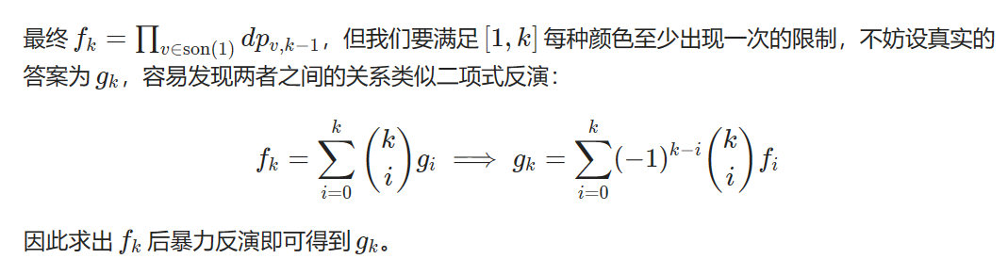
CF1707D Partial Virtual Trees

Slide 21
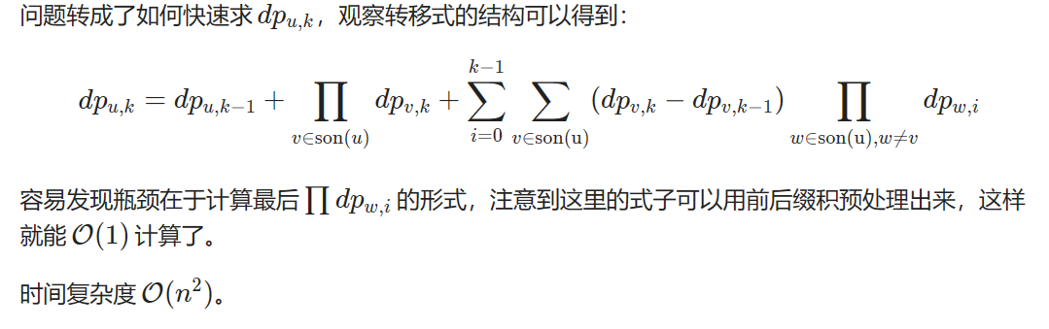
CF1707D Partial Virtual Trees

